Slide 1

CSCI 466: Networks
Lecture 2: Network Edge, Network Core
Reese Pearsall
Fall 2024
https://www.cs.montana.edu/pearsall/classes/fall2024/466/main.html

Slide 2
Announcements
Make sure to get the CSCI 466 role on Discord!
Fill out the course questionnaire
You can call me “Reese”

Slide 3








End to End Communication
Devices that are connected to network are called hosts or end systems
Wireless endpoints
Wired endpoints
A typical home network
How does out network get access through other networks?

Slide 4

End to End Communication
Devices that are connected to network are called hosts or end systems
End systems are connected together by a network of communication links and packet switches
Communication Link
A typical home network
wireless access
point (54 Mbps)
Packet Switch

Slide 5
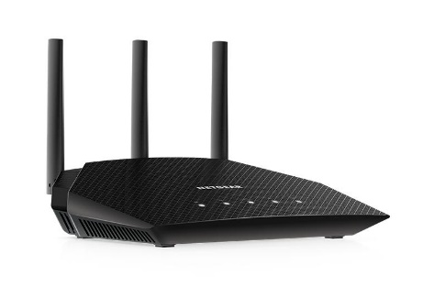

End to End Communication
Devices that are connected to network are called hosts or end systems
End systems are connected together by a network of communication links and packet switches
Communication Link
A typical home network
wireless access
point (54 Mbps)
Packet Switch
The most common packet switch we see is called a router

Slide 6

End to End Communication
Devices that are connected to network are called hosts or end systems
End systems are connected together by a network of communication links and packet switches
A packet switch takes a packet arriving on one of its incoming communication links and forwards that packet on one of its outgoing communication links
Packet Switch
A typical home network
The most common packet switch we see is called a router

Slide 7
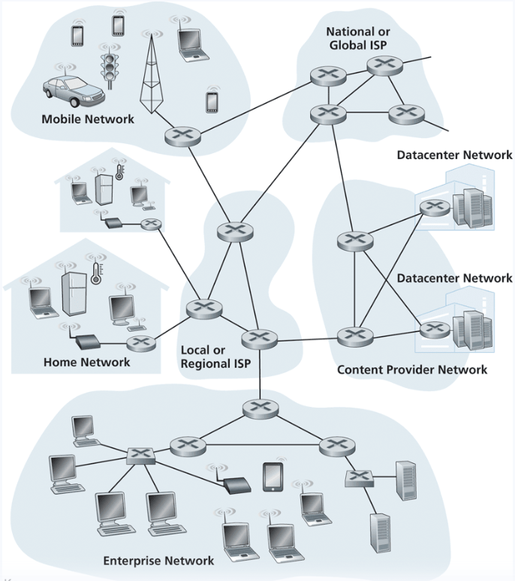




End to End Communication
End systems gain access to the internet through Internet Service Providers (ISPs)

Slide 8
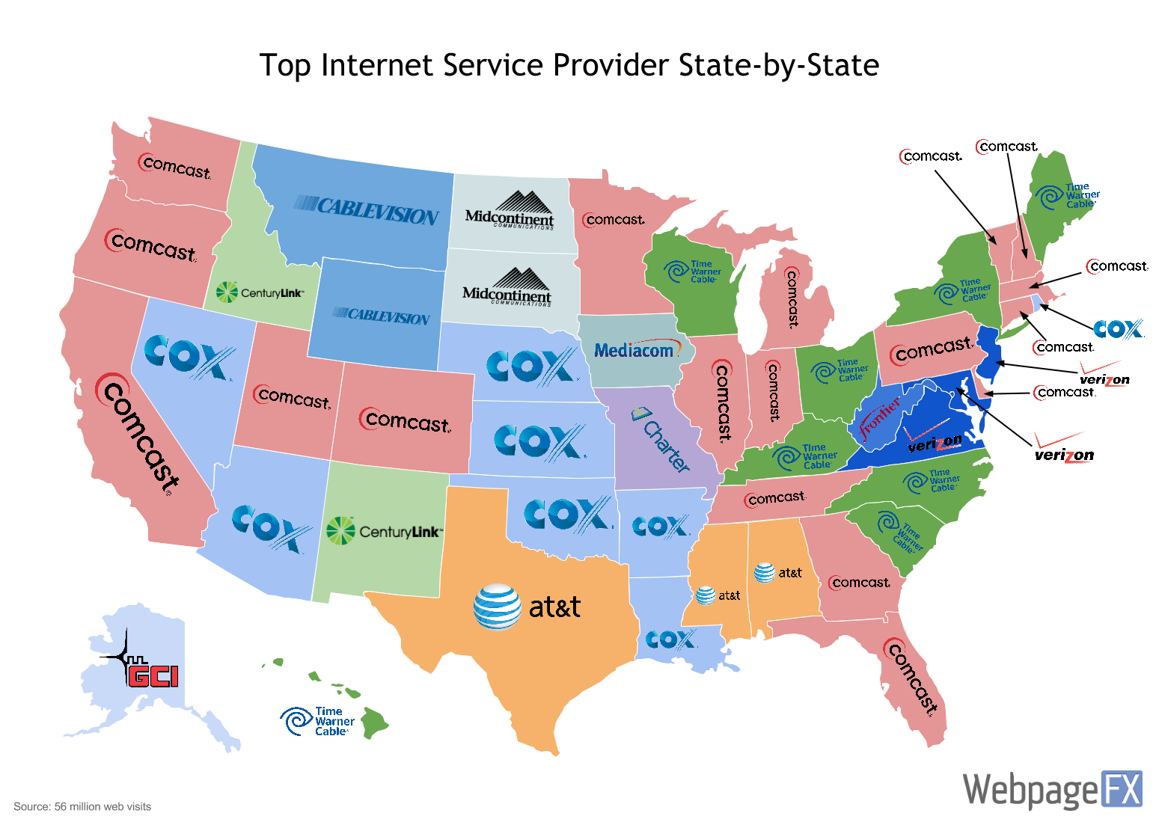

End to End Communication
End systems gain access to the internet through Internet Service Providers (ISPs)

Slide 9





End to End Communication
End systems gain access to the internet through Internet Service Providers (ISPs)

Slide 10
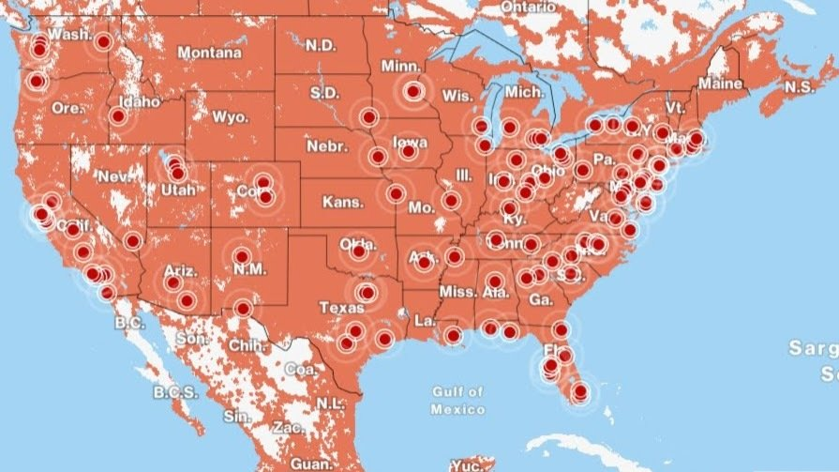

End to End Communication
End systems gain access to the internet through Internet Service Providers (ISPs)

Slide 11




End to End Communication
“End-to-end communication”
Most hosts can be classified into two categories:
Clients
Servers

Slide 12



End to End Communication
“End-to-end communication”
Most hosts can be classified into two categories:
Clients (Desktops, Laptops, Phones)
Servers (Powerful computers that store web pages, videos, emails, etc)

Slide 13
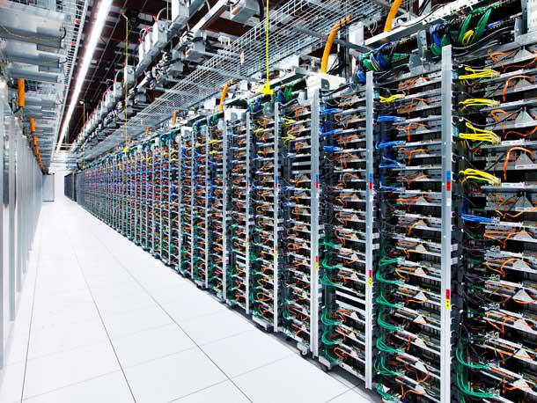
End to End Communication
Servers typically reside in large datacenters
“End-to-end communication”

Slide 14

Network Edge
The network edge consists of end systems

Slide 15


Network Edge
An access network is the network that physically connects an end system to the first router
The way that homes and enterprises get connected to the internet

Slide 16
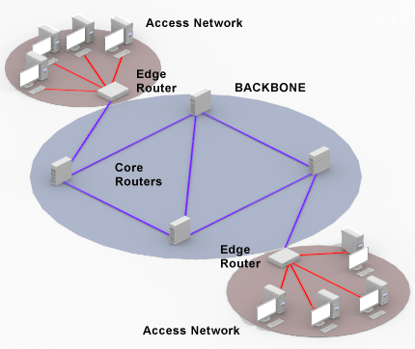
Network Edge
An access network is the network that physically connects an end system to the first router
The way that homes and enterprises get connected to the internet

Slide 17
End to End Communication
“Edge Routers” act as the boundary between a private network and a public network

Slide 18
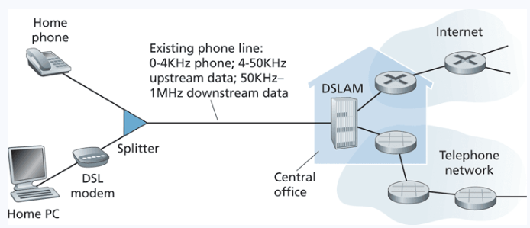
Home Network Access
Digital Subscriber Line (DSL)
Uses existing telephone line to connect to internet and transmit data

Slide 19
Home Network Access
Digital Subscriber Line (DSL)
Uses existing telephone line to connect to internet and transmit data

Slide 20
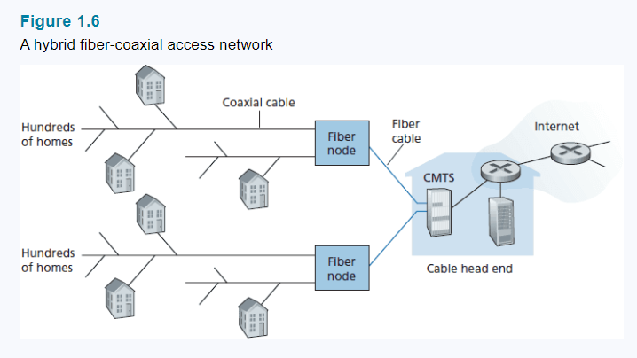
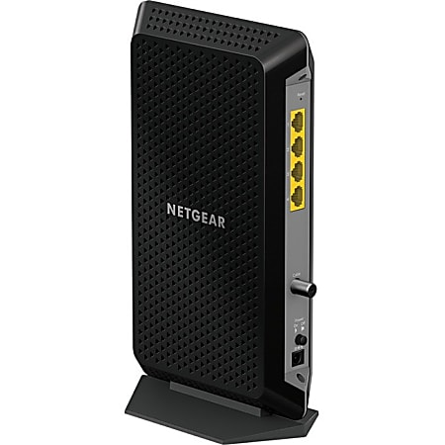
Home Network Access
Cable Internet Access
Homes will require a modem, which connects to a home PC with an Ethernet cable
Uses existing television cable lines to connect to internet and transmit data
*Shared broadcast medium

Slide 21
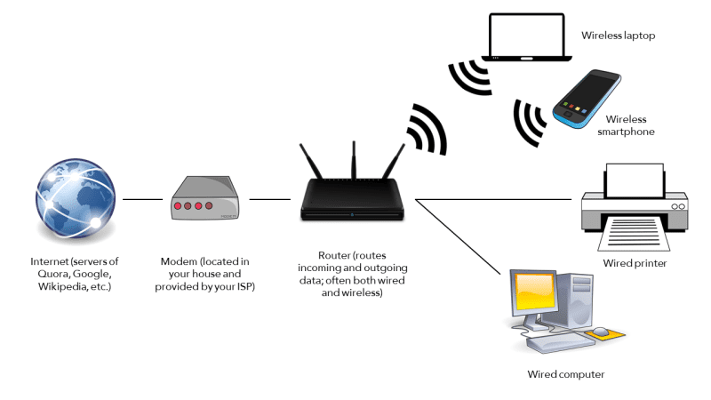
Home Network Access
Cable Internet Access
(WLAN)
Homes will require a modem, which connects to a home PC with an Ethernet cable
Uses existing television cable lines to connect to internet and transmit data

Slide 22
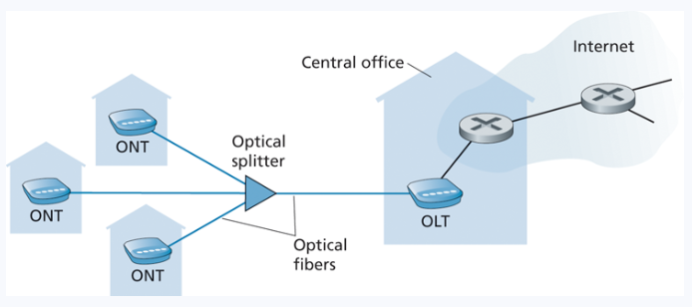

Home Network Access
Fiber Internet Access (FTTH)
Connects homes to a shared fiber cable

Slide 23
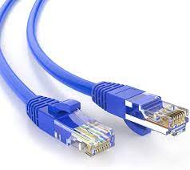
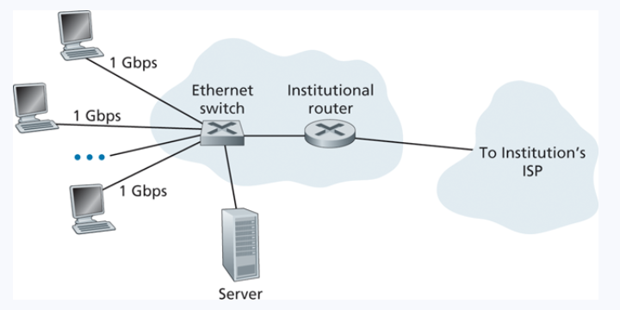
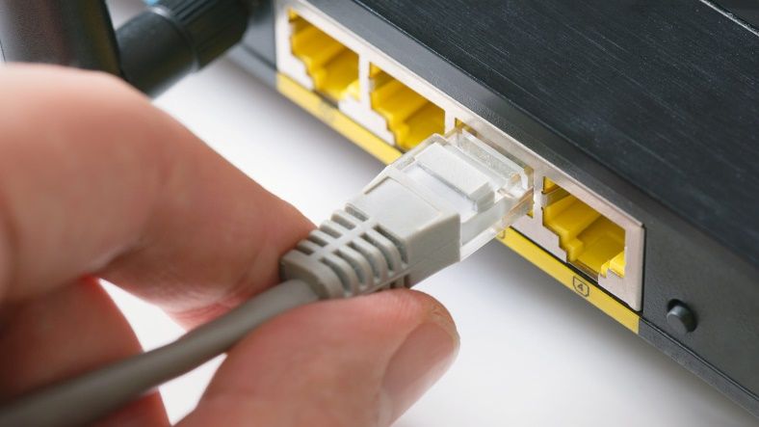
Home Network Access
Ethernet Internet Access

Slide 24
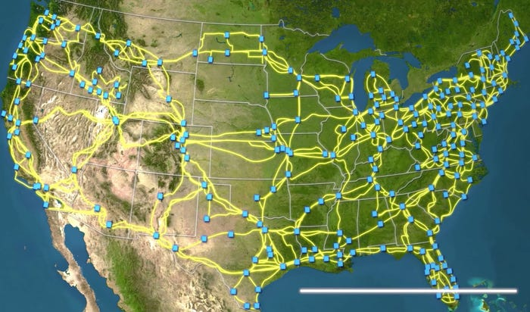
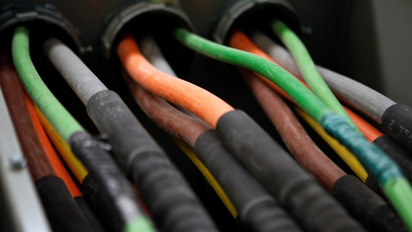
Ok, but like how ?
???

Slide 25



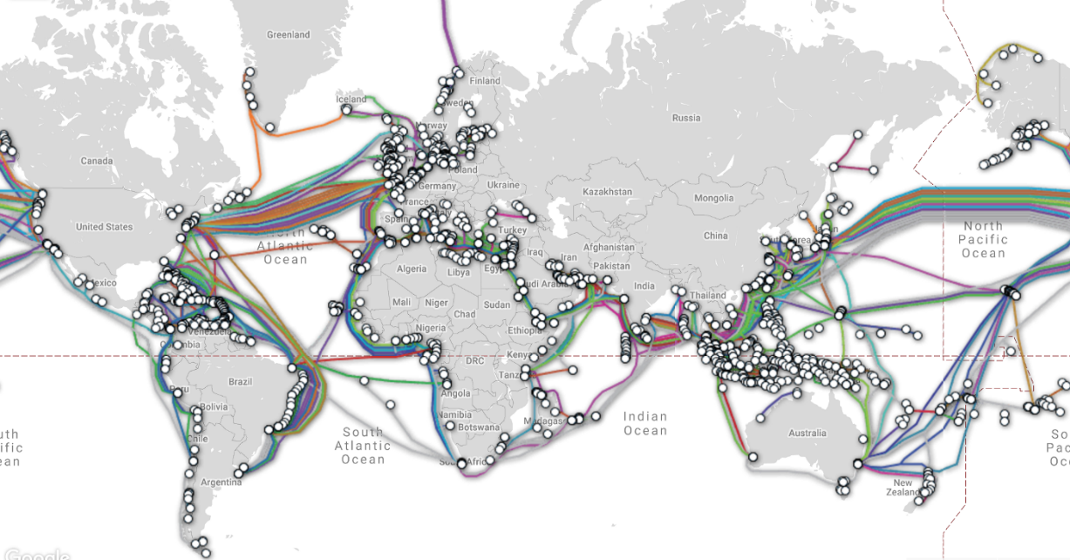
Ok, but like how ?

Slide 26
INFRAPEDIA

Slide 27
https://www.youtube.com/watch?v=d0gs497KApU

Slide 28
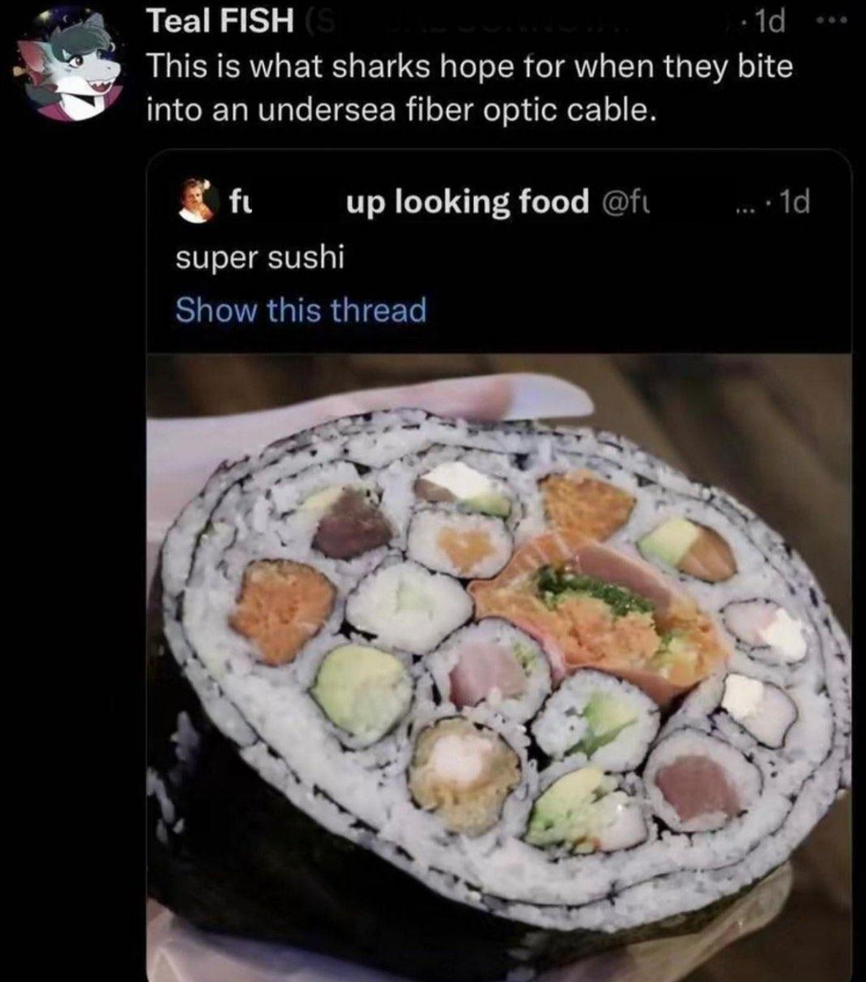


Slide 29
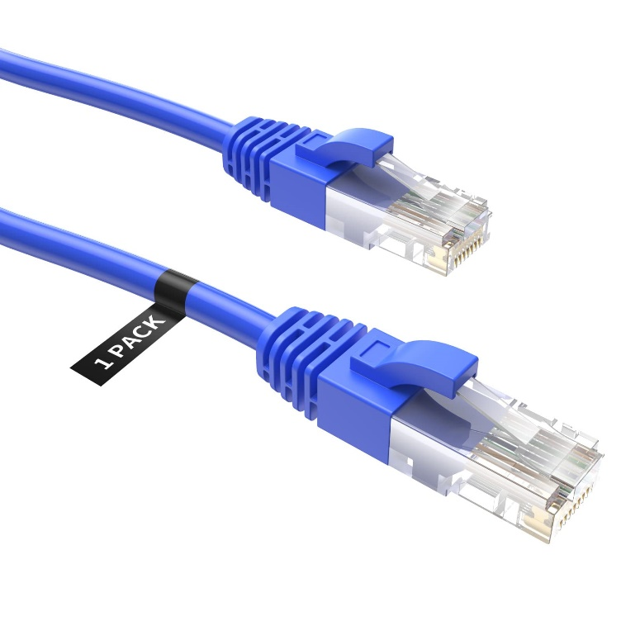
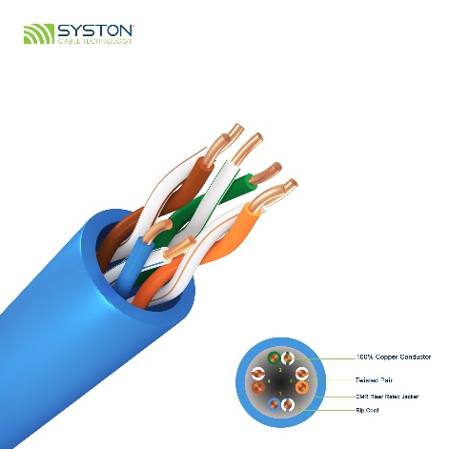
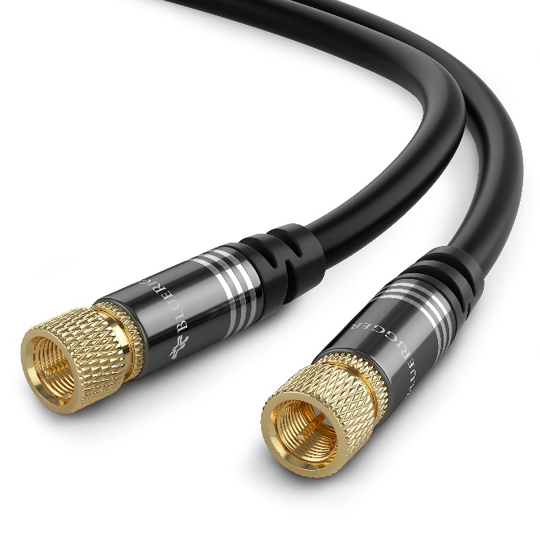
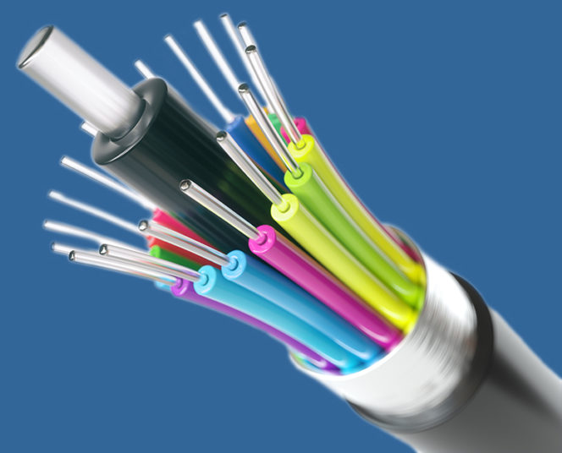
Physical Mediums
Twisted-Pair Copper Wire
Coaxial Cable
Fiber Optic Cable

Slide 30
Physical Mediums
Twisted-Pair Copper Wire
Fiber Optic Cable
Cheap
Easy to install
can handle a variety signals
Expensive
A bit more difficult to install
Much higher speeds, can transmit long distances

Slide 31
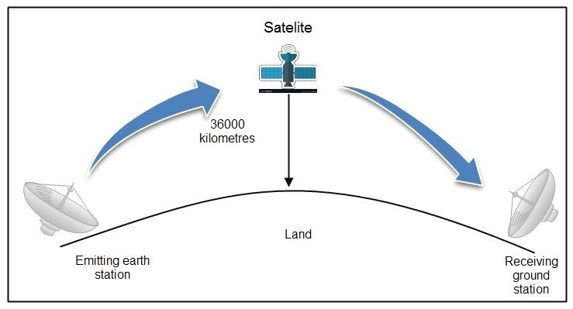
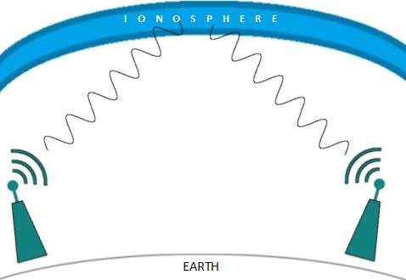
Ok, but like how ?
Radio
Microwave
Infrared
Satellite

Slide 32
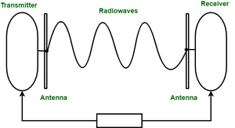
Ok, but like how ?
Guided Medium
Unguided Medium

Slide 33
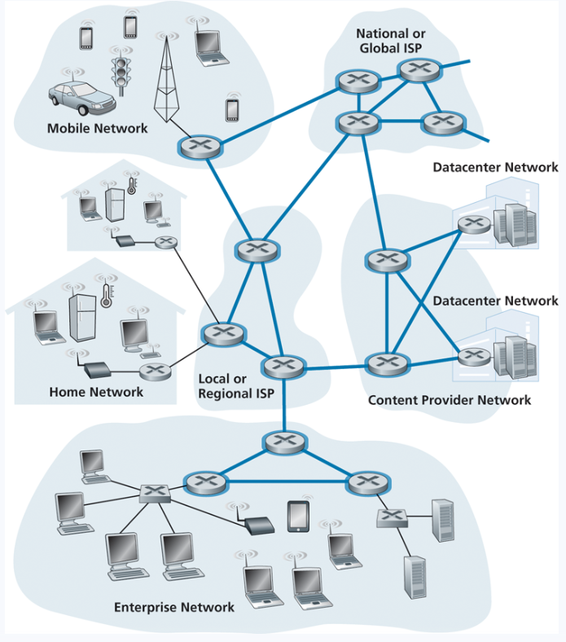
The Network Core
End systems are connected together by a network of communication links and packet switches
A packet switch takes a packet arriving on one of its incoming communication links and forwards that packet on one of its outgoing communication links
Each communication link has its own transmission rate (bits/sec)
10 Mbps
500 kbps
100 kbps

Slide 34
The Network Core
Messages going from A to B are split into packets
“Good morning, I hope you are having a good day!”
Generated Packet
To: Host A
John Paxton
192.42.98.11
From: Host B
Reese Pearsall
192.5.223.42
Good morning, I hope you are having a good day!
1500 Bytes

Slide 35
The Network Core
Messages going from A to B are split into packets
“Good morning, I hope you are having a good day!”
P
Generated Packet
To: Host A
John Paxton
192.42.98.11
From: Host B
Reese Pearsall
192.5.223.42
Good morning, I hope you are having a good day!
1500 Bytes

Slide 36
The Network Core
Messages going from A to B are split into packets
“Good morning, I hope you are having a good day!”
Generated Packet
To: Host A
John Paxton
192.42.98.11
From: Host B
Reese Pearsall
192.5.223.42
P
Good morning, I hope you are having a good day!
1500 Bytes

Slide 37
The Network Core
Messages going from A to B are split into packets
“Good morning, I hope you are having a good day!”
P
Generated Packet
To: Host A
John Paxton
192.42.98.11
From: Host B
Reese Pearsall
192.5.223.42
Good morning, I hope you are having a good day!
1500 Bytes

Slide 38
The Network Core
Messages going from A to B are split into packets
“Good morning, I hope you are having a good day!”
Generated Packet
To: Host A
John Paxton
192.42.98.11
From: Host B
Reese Pearsall
192.5.223.42
P
Good morning, I hope you are having a good day!
1500 Bytes

Slide 39
The Network Core
Messages going from A to B are split into packets
“Good morning, I hope you are having a good day!”
Generated Packet
To: Host A
John Paxton
192.42.98.11
From: Host B
Reese Pearsall
192.5.223.42
Good morning, I hope you are having a good day!
P
1500 Bytes

Slide 40
The Network Core
Messages going from A to B are split into packets
“Good morning, I hope you are having a good day!”
Generated Packet
To: Host A
John Paxton
192.42.98.11
From: Host B
Reese Pearsall
192.5.223.42
Good morning, I hope you are having a good day!
P
1500 Bytes

Slide 41
The Network Core
Messages going from A to B are split into packets
“Good morning, I hope you are having a good day!”
Generated Packet
To: Host A
John Paxton
192.42.98.11
From: Host B
Reese Pearsall
192.5.223.42
Good morning, I hope you are having a good day!
P
1500 Bytes

Slide 42
The Network Core
Messages going from A to B are split into packets
“Good morning, I hope you are having a good day!”
Generated Packet
To: Host A
John Paxton
192.42.98.11
From: Host B
Reese Pearsall
192.5.223.42
Good morning, I hope you are having a good day!
P
1500 Bytes

Slide 43
The Network Core
Messages going from A to B are split into packets
Packets are generally small, and cannot exceed a certain size
P

Slide 44
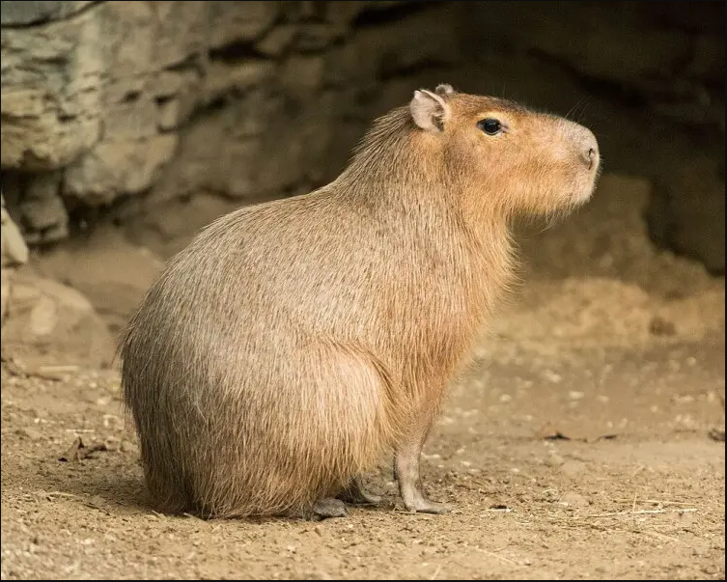
The Network Core
Messages going from A to B are split into packets
Packets are generally small, and cannot exceed a certain size
What if we are transmitting large pieces of data?

Slide 45
The Network Core
Messages going from A to B are split into packets
Packets are generally small, and cannot exceed a certain size
What if we are transmitting large pieces of data?
We must split it up!

Slide 46
The Network Core
Messages going from A to B are split into packets
Packets are generally small, and cannot exceed a certain size
To: Host A
John Paxton
192.42.98.11
From: Host B
Reese Pearsall
192.5.223.42
P1
What if we are transmitting large pieces of data?
To: Host A
John Paxton
192.42.98.11
From: Host B
Reese Pearsall
192.5.223.42
P2
We must split it up!
To: Host A
John Paxton
192.42.98.11
From: Host B
Reese Pearsall
192.5.223.42
P3

Slide 47
The Network Core
Messages going from A to B are split into packets
Packets are generally small, and cannot exceed a certain size
To: Host A
John Paxton
192.42.98.11
From: Host B
Reese Pearsall
192.5.223.42
P1
What if we are transmitting large pieces of data?
P3
P2
To: Host A
John Paxton
192.42.98.11
From: Host B
Reese Pearsall
192.5.223.42
P1
P2
We must split it up!
To: Host A
John Paxton
192.42.98.11
From: Host B
Reese Pearsall
192.5.223.42
P3

Slide 48
The Network Core
Messages going from A to B are split into packets
Packets are generally small, and cannot exceed a certain size
To: Host A
John Paxton
192.42.98.11
From: Host B
Reese Pearsall
192.5.223.42
P1
What if we are transmitting large pieces of data?
P1
P3
To: Host A
John Paxton
192.42.98.11
From: Host B
Reese Pearsall
192.5.223.42
P2
P2
We must split it up!
To: Host A
John Paxton
192.42.98.11
From: Host B
Reese Pearsall
192.5.223.42
P3

Slide 49
The Network Core
Messages going from A to B are split into packets
Packets are generally small, and cannot exceed a certain size
To: Host A
John Paxton
192.42.98.11
From: Host B
Reese Pearsall
192.5.223.42
P1
What if we are transmitting large pieces of data?
P1
To: Host A
John Paxton
192.42.98.11
From: Host B
Reese Pearsall
192.5.223.42
P3
P2
P2
We must split it up!
To: Host A
John Paxton
192.42.98.11
From: Host B
Reese Pearsall
192.5.223.42
P3

Slide 50
The Network Core
Messages going from A to B are split into packets
Packets are generally small, and cannot exceed a certain size
To: Host A
John Paxton
192.42.98.11
From: Host B
Reese Pearsall
192.5.223.42
P1
What if we are transmitting large pieces of data?
To: Host A
John Paxton
192.42.98.11
From: Host B
Reese Pearsall
192.5.223.42
P3
P2
P1
We must split it up!
P2
To: Host A
John Paxton
192.42.98.11
From: Host B
Reese Pearsall
192.5.223.42
P3

Slide 51
The Network Core
Messages going from A to B are split into packets
Packets are generally small, and cannot exceed a certain size
To: Host A
John Paxton
192.42.98.11
From: Host B
Reese Pearsall
192.5.223.42
P1
What if we are transmitting large pieces of data?
To: Host A
John Paxton
192.42.98.11
From: Host B
Reese Pearsall
192.5.223.42
P3
P2
P1
We must split it up!
To: Host A
John Paxton
192.42.98.11
From: Host B
Reese Pearsall
192.5.223.42
P2
P3

Slide 52
The Network Core
Messages going from A to B are split into packets
Packets are generally small, and cannot exceed a certain size
To: Host A
John Paxton
192.42.98.11
From: Host B
Reese Pearsall
192.5.223.42
P1
What if we are transmitting large pieces of data?
To: Host A
John Paxton
192.42.98.11
From: Host B
Reese Pearsall
192.5.223.42
P2
P3
We must split it up!
P1
To: Host A
John Paxton
192.42.98.11
From: Host B
Reese Pearsall
192.5.223.42
P2
P3

Slide 53
The Network Core
Messages going from A to B are split into packets
Packets are generally small, and cannot exceed a certain size
To: Host A
John Paxton
192.42.98.11
From: Host B
Reese Pearsall
192.5.223.42
P1
What if we are transmitting large pieces of data?
To: Host A
John Paxton
192.42.98.11
From: Host B
Reese Pearsall
192.5.223.42
P2
P3
We must split it up!
To: Host A
John Paxton
192.42.98.11
From: Host B
Reese Pearsall
192.5.223.42
P2
P1
P3

Slide 54
The Network Core
Messages going from A to B are split into packets
Packets are generally small, and cannot exceed a certain size
To: Host A
John Paxton
192.42.98.11
From: Host B
Reese Pearsall
192.5.223.42
P1
What if we are transmitting large pieces of data?
To: Host A
John Paxton
192.42.98.11
From: Host B
Reese Pearsall
192.5.223.42
P2
We must split it up!
P3
To: Host A
John Paxton
192.42.98.11
From: Host B
Reese Pearsall
192.5.223.42
P2
P1
P3

Slide 55
The Network Core
Messages going from A to B are split into packets
Packets are generally small, and cannot exceed a certain size
To: Host A
John Paxton
192.42.98.11
From: Host B
Reese Pearsall
192.5.223.42
P1
What if we are transmitting large pieces of data?
To: Host A
John Paxton
192.42.98.11
From: Host B
Reese Pearsall
192.5.223.42
P2
We must split it up!
To: Host A
John Paxton
192.42.98.11
From: Host B
Reese Pearsall
192.5.223.42
P3
P1
P3
P2

Slide 56
The Network Core
Messages going from A to B are split into packets
Packets are generally small, and cannot exceed a certain size
To: Host A
John Paxton
192.42.98.11
From: Host B
Reese Pearsall
192.5.223.42
P1
What if we are transmitting large pieces of data?
To: Host A
John Paxton
192.42.98.11
From: Host B
Reese Pearsall
192.5.223.42
P2
We must split it up!
To: Host A
John Paxton
192.42.98.11
From: Host B
Reese Pearsall
192.5.223.42
P3
P1
P3
P2

Slide 57
The Network Core
Messages going from A to B are split into packets
Packets are generally small, and cannot exceed a certain size
To: Host A
John Paxton
192.42.98.11
From: Host B
Reese Pearsall
192.5.223.42
P1
What if we are transmitting large pieces of data?
To: Host A
John Paxton
192.42.98.11
From: Host B
Reese Pearsall
192.5.223.42
P2
We must split it up!
To: Host A
John Paxton
192.42.98.11
From: Host B
Reese Pearsall
192.5.223.42
P1
P3
P2
P3

Slide 58
The Network Core
Messages going from A to B are split into packets
Packets are generally small, and cannot exceed a certain size
To: Host A
John Paxton
192.42.98.11
From: Host B
Reese Pearsall
192.5.223.42
P1
What if we are transmitting large pieces of data?
To: Host A
John Paxton
192.42.98.11
From: Host B
Reese Pearsall
192.5.223.42
P2
We must split it up!
To: Host A
John Paxton
192.42.98.11
From: Host B
Reese Pearsall
192.5.223.42
P1
P3
P2
P3

Slide 59
The Network Core
Messages going from A to B are split into packets
Packets are generally small, and cannot exceed a certain size
To: Host A
John Paxton
192.42.98.11
From: Host B
Reese Pearsall
192.5.223.42
P1
What if we are transmitting large pieces of data?
To: Host A
John Paxton
192.42.98.11
From: Host B
Reese Pearsall
192.5.223.42
P2
We must split it up!
To: Host A
John Paxton
192.42.98.11
From: Host B
Reese Pearsall
192.5.223.42
P3
P2
P3
P1

Slide 60
The Network Core
Messages going from A to B are split into packets
Packets are generally small, and cannot exceed a certain size
Final Result:
To: Host A
John Paxton
192.42.98.11
From: Host B
Reese Pearsall
192.5.223.42
P2
To: Host A
John Paxton
192.42.98.11
From: Host B
Reese Pearsall
192.5.223.42
P3
To: Host A
John Paxton
192.42.98.11
From: Host B
Reese Pearsall
192.5.223.42
P1
P2
P3
P1

Slide 61

The Network Core
Messages going from A to B are split into packets
Packets are generally small, and cannot exceed a certain size
Lost, Discarded, Corrupt
P1
To: Host A
John Paxton
192.42.98.11
From: Host B
Reese Pearsall
192.5.223.42
P1
P2
To: Host A
John Paxton
192.42.98.11
From: Host B
Reese Pearsall
192.5.223.42
P3
P2
P3

Slide 62
The Network Core
Messages going from A to B are split into packets
Packets are generally small, and cannot exceed a certain size
Final Result:
To: Host A
John Paxton
192.42.98.11
From: Host B
Reese Pearsall
192.5.223.42
P2
Solution?
To: Host A
John Paxton
192.42.98.11
From: Host B
Reese Pearsall
192.5.223.42
P3
To: Host A
John Paxton
192.42.98.11
From: Host B
Reese Pearsall
192.5.223.42
P1
P2
P3
P1

Slide 63
The Network Core
Messages going from A to B are split into packets
Packets are generally small, and cannot exceed a certain size
Final Result:
To: Host A
John Paxton
192.42.98.11
From: Host B
Reese Pearsall
192.5.223.42
P2
2/3
Solution?
To: Host A
John Paxton
192.42.98.11
From: Host B
Reese Pearsall
192.5.223.42
P3
3/3
To: Host A
John Paxton
192.42.98.11
From: Host B
Reese Pearsall
192.5.223.42
P1
P2
P3
P1
1/3

Slide 64
The Network Core
Messages going from A to B are split into packets
Packets are generally small, and cannot exceed a certain size
Final Result:
P2
To: Host A
John Paxton
192.42.98.11
From: Host B
Reese Pearsall
192.5.223.42
1/3
Solution?
To: Host A
John Paxton
192.42.98.11
From: Host B
Reese Pearsall
192.5.223.42
P3
2/3
To: Host A
John Paxton
192.42.98.11
From: Host B
Reese Pearsall
192.5.223.42
P1
P2
P3
P1
3/3

Slide 65
The Network Core
Messages going from A to B are split into packets
Packets are generally small, and cannot exceed a certain size
Final Result:
P2
To: Host A
John Paxton
192.42.98.11
From: Host B
Reese Pearsall
192.5.223.42
1/3
Solution?
To: Host A
John Paxton
192.42.98.11
From: Host B
Reese Pearsall
192.5.223.42
P3
2/3
To: Host A
John Paxton
192.42.98.11
From: Host B
Reese Pearsall
192.5.223.42
P1
P2
P3
P1
3/3

Slide 66
Anatomy of a Packet
What a packet looks like depends on where it’s at in its journey!
“Hello John.”

Slide 67
Anatomy of a Packet
What a packet looks like depends on where it’s at in its journey!
User-level message
“Hello John.”

Slide 68
Anatomy of a Packet
What a packet looks like depends on where it’s at in its journey!
Intended receiver and sender of message
“Hello John.”
To: John
From: Reese
“Hello John.”

Slide 69
Anatomy of a Packet
What a packet looks like depends on where it’s at in its journey!
Address of Sender and Receiver
To: 555 Bozeman Ave
From: 123 Highland Ave
“Hello John.”
“Hello John.”
To: John
From: Reese
“Hello John.”
To: John
From: Reese

Slide 70
Anatomy of a Packet
What a packet looks like depends on where it’s at in its journey!
Specific location of sender and receiver’s homes
To: Apt B
From: Apt F
To: 555 Bozeman Ave
From: 123 Highland Ave
To: 555 Bozeman Ave
From: 123 Highland Ave
“Hello John.”
“Hello John.”
“Hello John.”
To: John
From: Reese
“Hello John.”
To: John
From: Reese
To: John
From: Reese

Slide 71

Anatomy of a Packet
What a packet looks like depends on where it’s at in its journey!
Specific location of sender and receiver’s homes
To: Apt B
From: Apt F
To: 555 Bozeman Ave
From: 123 Highland Ave
To: 555 Bozeman Ave
From: 123 Highland Ave
“Hello John.”
“Hello John.”
“Hello John.”
To: John
From: Reese
“Hello John.”
To: John
From: Reese
To: John
From: Reese
Our original message gets encapsulated with many pieces of information
These pieces of information help make sure our mail get sent to the correct place

Slide 72
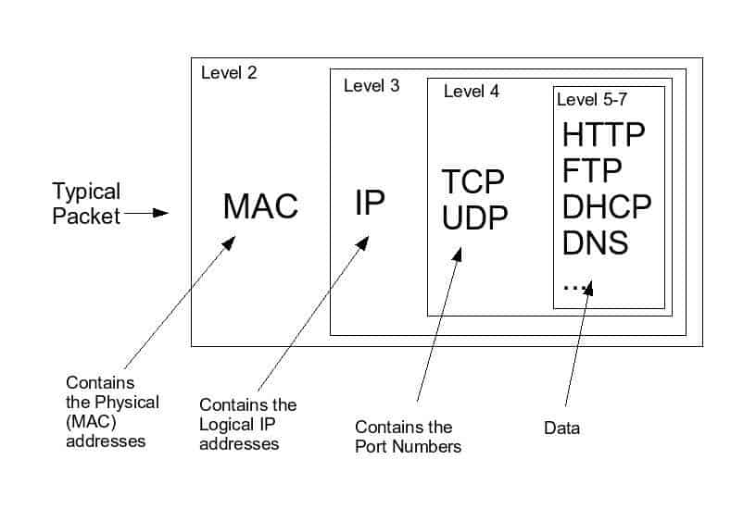
Anatomy of a Packet
It’s a complicated system!

Slide 73
Application Layer
OSI Model
Open Systems Interconnection Model
Presentation Layer
Session Layer
Transport Layer
Network Layer
Data Link Layer
Physical Layer

Slide 74
Application Layer
OSI Model
Presentation Layer
Application Layer
Session Layer
Messages from Network Applications
Transport Layer
Network Layer
Physical Layer
Data Link Layer
Bits being transmitted over a copper wire
Physical Layer

Slide 75
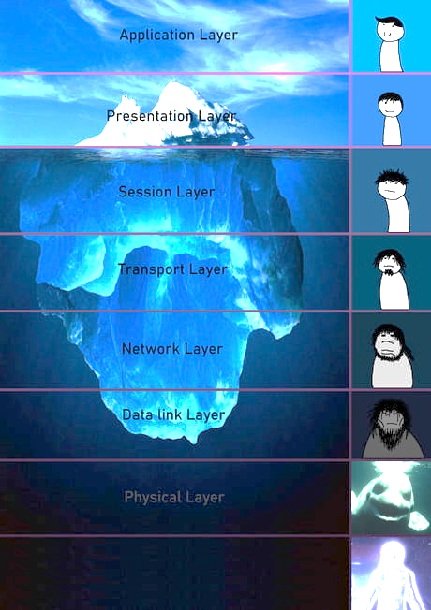

Slide 76
Questions?

